Slide 1
Introduction
Introduction to Algorithms
Complexity, Examples
Algorithms Design Techniques
Why is analysis of an Algorithm important?
Asymptotic Notations and Solving Methods

Slide 2
Introduction to Algorithms
A sequence of finite steps to solve a particular problem.
An Algorithm is a set of well-defined instructions designed to perform a specific set of tasks.
Designing an algorithm is important before writing the program code as the algorithm explains the logic even before the code is developed.

Slide 3
Properties of an Algorithm
Input: The inputs of the algorithm are defined and specific for the type of algorithm that is being used.
Output: The outputs are specifically related to the inputs.
Definiteness: The steps in the algorithm are very clear and detailed. There is no ambiguousness in the steps.
Effectiveness: The steps in the algorithm are doable, not redundant, and provide results desired.
Finiteness: The algorithm has an end to the number of steps it follows.

Slide 4
Algorithm Representation
Using Flowchart - Algorithms can be represented as a flowchart. At the top of the flowchart is the start. The start bubble is then connected to whatever can happen next. Sometimes it's one bubble, sometimes it's more than one. Those bubbles are connected to more bubbles depending on what can happen next in the algorithm. The flowchart ends when there are no more possibilities for next steps.
Using Pseudocode - It is an informal and contrived way of writing programs in which you represent the sequence of actions and instructions (aka algorithms) in a form that humans can easily understand.

Slide 5
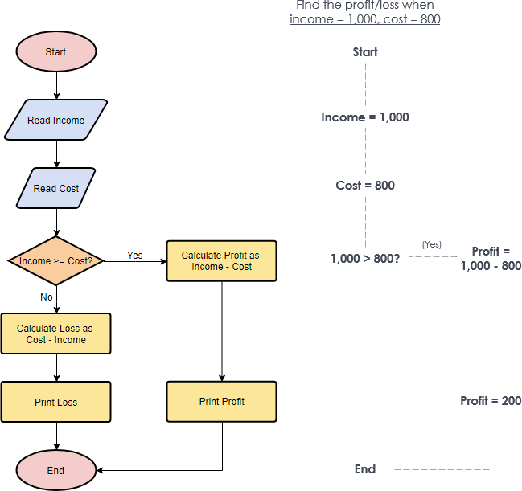
Flowchart example

Slide 6
Pseudocode Example

Slide 7
Performance Analysis of an algorithm
Performance of an algorithm is a process of making evaluative judgement about algorithms.
It means predicting the resources which are required to an algorithm to perform its task.
To compare algorithms, we use a set of parameters or set of elements.

Slide 8
Generally, the performance of an algorithm depends on the following elements:
Whether that algorithm is providing the exact solution for the problem?
Whether it is easy to understand?
Whether it is easy to implement?
How much space (memory) it requires to solve the problem?
How much time it takes to solve the problem? Etc.,
When we want to analyse an algorithm, we consider only the space and time required by that particular algorithm and we ignore all the remaining elements.

Slide 9
Space and Time Complexity
Space Complexity - Space required to complete the task of that algorithm. It includes program space and data space.
Time Complexity - Time required to complete the task of that algorithm.

Slide 10
Space Complexity
Total amount of computer memory required by an algorithm to complete its execution is called as space complexity of that algorithm.
For any algorithm, memory is required for the following purposes:
To store program instructions.
To store constant values.
To store variable values.
And for few other things like funcion calls, jumping statements etc,.

Slide 11
Generally, when a program is under execution it uses the computer memory for THREE reasons:
Instruction Space: It is the amount of memory used to store compiled version of instructions.
Environmental Stack: It is the amount of memory used to store information of partially executed functions at the time of function call.
Data Space: It is the amount of memory used to store all the variables and constants.
When we want to perform analysis of an algorithm based on its Space complexity, we consider only Data Space and ignore Instruction Space as well as Environmental Stack.

Slide 12

Example 1
It requires 2 bytes of memory to store variable 'a' and another 2 bytes of memory is used for return value.
That means, totally it requires 4 bytes of memory to complete its execution. And this 4 bytes of memory is fixed for any input value of 'a'. This space complexity is said to be Constant Space Complexity.
If any algorithm requires a fixed amount of space for all input values then that space complexity is said to be Constant Space Complexity.

Slide 13
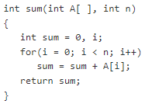
Example 2
It requires:
'n*2' bytes of memory to store array variable 'a[ ]' 2 bytes of memory for integer parameter 'n' 4 bytes of memory for local integer variables 'sum' and 'i' (2 bytes each) 2 bytes of memory for return value. That means, totally it requires '2n+8' bytes of memory to complete its execution. Here, the total amount of memory required depends on the value of 'n'. As 'n' value increases the space required also increases proportionately.
This type of space complexity is said to be Linear Space Complexity.

Slide 14
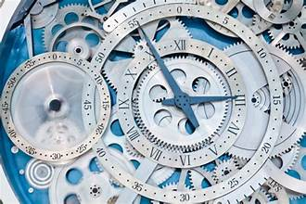
Time Complexity
The time complexity of an algorithm is the total amount of time required by an algorithm to complete its execution.
Experimental Analysis v/s Asymptotic Analysis

Slide 15
Generally, the running time of an algorithm depends upon the following...
Whether it is running on Single processor machine or Multi processor machine.
Whether it is a 32 bit machine or 64 bit machine.
Read and Write speed of the machine.
The amount of time required by an algorithm to perform Arithmetic operations, logical operations, return value and assignment operations etc.,
Input data
When we calculate time complexity of an algorithm, we consider only input data and ignore the remaining things, as they are machine dependent. We check only, how our program is behaving for the different input values to perform all the operations like Arithmetic, Logical, Return value and Assignment etc.,

Slide 16
Assumptions
To calculate the time complexity of an algorithm, we need to define a model machine. Let us assume a machine with following configuration...
It is a Single processor machine
It is a 32 bit Operating System machine
It performs sequential execution
It requires 1 unit of time for Arithmetic and Logical operations
It requires 1 unit of time for Assignment and Return value
It requires 1 unit of time for Read and Write operations

Slide 17


Example 1
In the above sample code, it requires 1 unit of time to calculate a+b and 1 unit of time to return the value. That means, totally it takes 2 units of time to complete its execution. And it does not change based on the input values of a and b. That means for all input values, it requires the same amount of time i.e. 2 units.
If any program requires a fixed amount of time for all input values then its time complexity is said to be Constant Time Complexity.

Slide 18
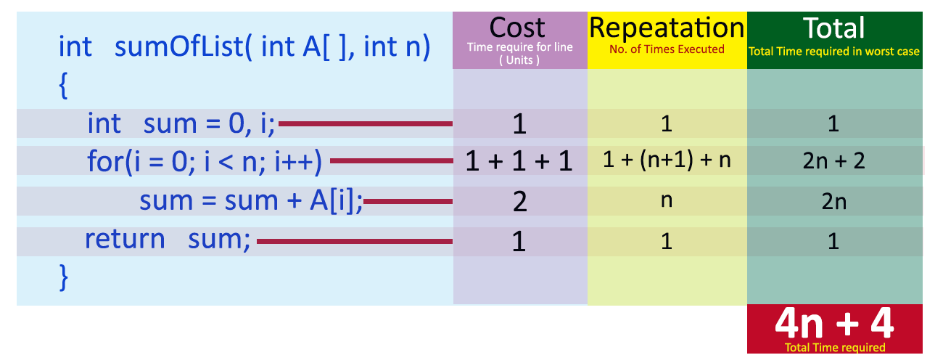
Example 2
For this code, time
complexity can be
calculated as follows..

Slide 19
In above calculation Cost is the amount of computer time required for a single operation in each line. Repeatation is the amount of computer time required by each operation for all its repeatations. Total is the amount of computer time required by each operation to execute. So above code requires '4n+4' Units of computer time to complete the task. Here the exact time is not fixed. And it changes based on the n value. If we increase the n value then the time required also increases linearly. Totally it takes '4n+4' units of time to complete its execution and it is Linear Time Complexity.
If the amount of time required by an algorithm is increased with the increase of input value then that time complexity is said to be Linear Time Complexity.

Slide 20
Growth of Function
Estimated running time for different values of ‘n’:
n = 10 => 44 steps
n = 100 => 404 steps
n = 1,000 => 4004 steps
n = 1,000,000 => 4,000,004 steps
As ‘n’ grows, the number of steps grow in linear proportion to n for this function “Sum”

Slide 21
Why Asymptotic Analysis
Let us consider the search problem (searching a given item) in a sorted array
Linear Search and Binary Search
Let us assume
we run the Linear Search on a fast computer A
and Binary Search on a slow computer B.
Experimental running times of two algorithms are difficult to directly compare unless the experiments are performed in the same hardware and software environments. Experiments can be done only on a limited set of test inputs; hence, they leave out the running times of inputs not included in the experiment
Input Size | Running time on A | Running time on B
10 | 2 sec | ~ 1 h
100 | 20 sec | ~ 1.8 h
10^6 | ~ 55.5 h | ~ 5.5 h
10^9 | ~ 6.3 years | ~ 8.3 h

Slide 22
Asymptotic Notations
Asymptotic notation of an algorithm is a mathematical representation of its complexity provides an understanding of how an algorithm performs with respect to input size.
In asymptotic notation, when we want to represent the complexity of an algorithm, we use only the most significant terms in the complexity of that algorithm and ignore least significant terms in the complexity of that algorithm (Here complexity can be Space Complexity or Time Complexity).
This gives us an approximation of the complexity of the algorithm.
Ignores lots of (machine dependent) details, concentrate on the bigger picture.

Slide 23
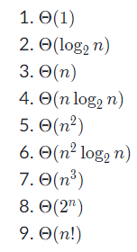
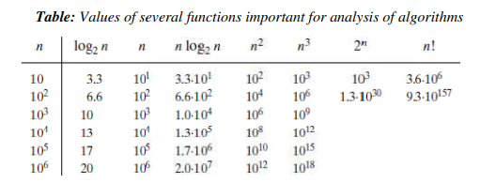
Functions in asymptotic notation
Here's a list of functions in asymptotic notation that we often encounter when analyzing algorithms, ordered by slowest to fastest growing:

Slide 24
Notations
Majorly, we use THREE types of Asymptotic Notations and those are as follows:
Big - Oh (O)
Big - Omega (Ω)
Big - Theta (Θ)

Slide 25
Big - Oh Notation (O)
Big - Oh notation is used to define the upper bound of an algorithm in terms of Time Complexity.
Big - Oh notation always indicates the maximum time required by an algorithm for all input values. That means Big - Oh notation describes the worst case of an algorithm time complexity.
Consider function f(n) as time complexity of an algorithm and g(n) is the most significant term.
If f(n) <= C g(n) for all n >= n₀, C > 0 and n₀ >= 1. Then we can represent f(n) as O(g(n)).

Slide 26
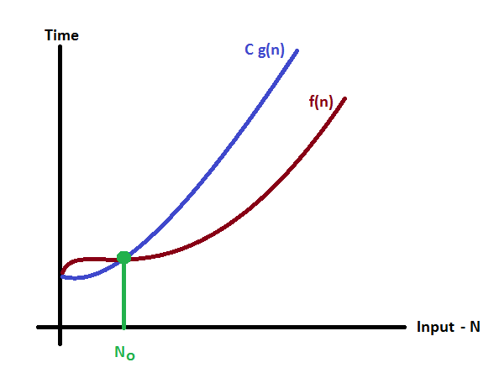

Slide 27
Example
Consider the following f(n) and g(n)... f(n) = 3n + 2 g(n) = n If we want to represent f(n) as O(g(n)) then it must satisfy f(n) <= C g(n) for all values of C > 0 and n₀>= 1 f(n) <= C g(n) ⇒3n + 2 <= C n Above condition is always TRUE for all values of C = 4 and n >= 2. By using Big - Oh notation we can represent the time complexity as: 3n + 2 = O(n)

Slide 28
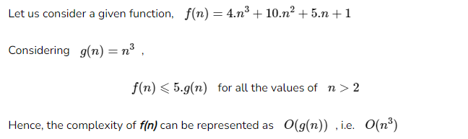
Example

Slide 29

